Slide 1
Minnesota High School Data Analytics (2018-2019)

Slide 2
Business Case: Analysis of Minnesota High Schools Standard test score performance during the academic year 2018-2019 Data Acquisition: Dataset was obtained in a CSV format Data Preparation: Using Azure ML, cleaned all missing data Data Visualization: Descriptive Statistics using Tableau
Content

Slide 3
Total number of features = 29 Total number of records = 491 No duplicate values found Missing values Full-time Teachers (4 records) Student/ Teacher Ratio (4 records) Unique Value High grade has only one unique value (12), all other features have more than one unique value.
Data Preparation

Slide 4
The Features (i.e., Variables) are segregated into three categories: Predictor Variable or Dependent Variable (Y): Variable that is being measured in the experiment. It changes as a result of the changes to the independent variables. Y : Rank and Standard score Noise: Variable that does not affect the dependent variable. Independent Variable: Variable whose change isn't affected by any other variable in the experiment. Independent variable is the cause, and dependent variable is the effect.
Exploratory Data Analysis

Slide 5
Exploratory Data Analysis - continued
Noise Variables
Independent Variables
School School URL District URL Address City URL Phone High grade
District City Zip County Low grade Is Title Is Charter Is Magnet Is Virtual No. of students | No. of full-time teachers Student/Teacher ratio Percent free/disc lunch Percent African American Percent American Indian Percent Asian Percent Hispanic Percent Pacific Islander Percent two or more races Percent White

Slide 6
Tableau is used for interactive data visualization, where charts are plotted using the independent variables (dimensions) against the dependent variable (Standard test score). Tableau is quick, simple and user-friendly. It can handle lot of data and provide calculations on datasets.
Data Visualization

Slide 7
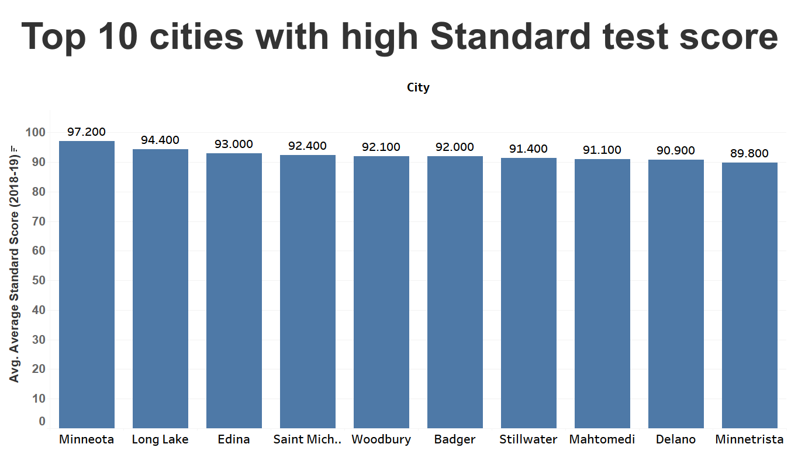

Slide 8
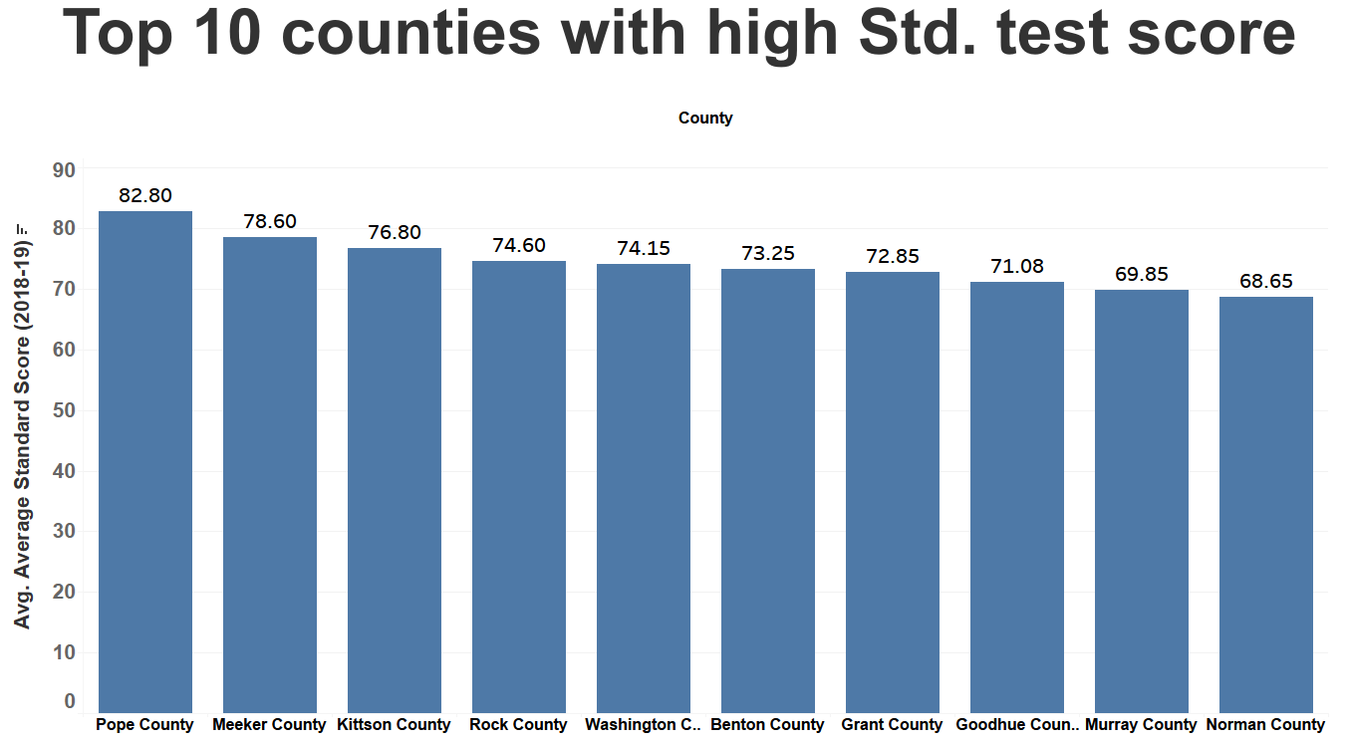

Slide 9
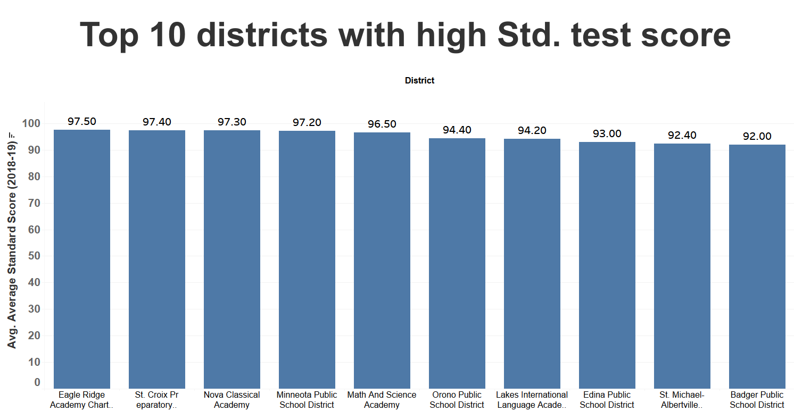

Slide 10
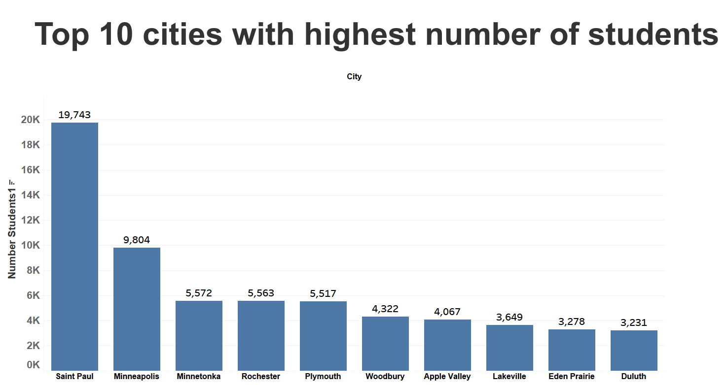

Slide 11
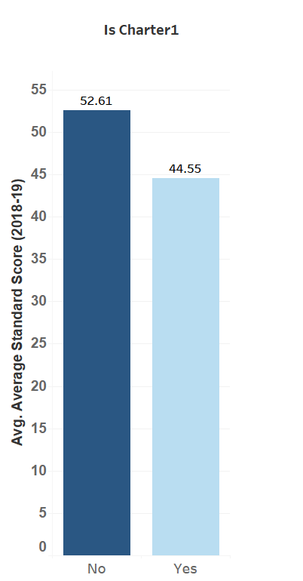
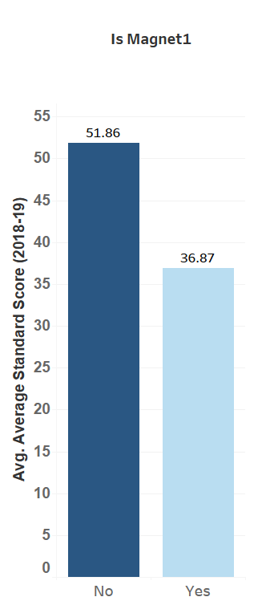
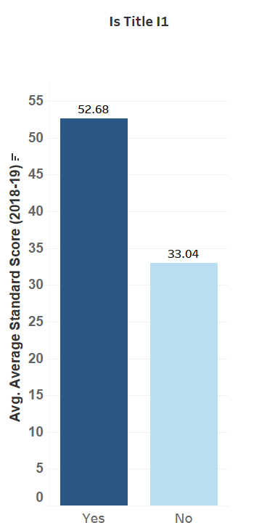

Charter, Magnet, Title and Virtual schools
The chart shows, Title schools have highest standard test scores than Charter, Magnet and Virtual schools.

Slide 12
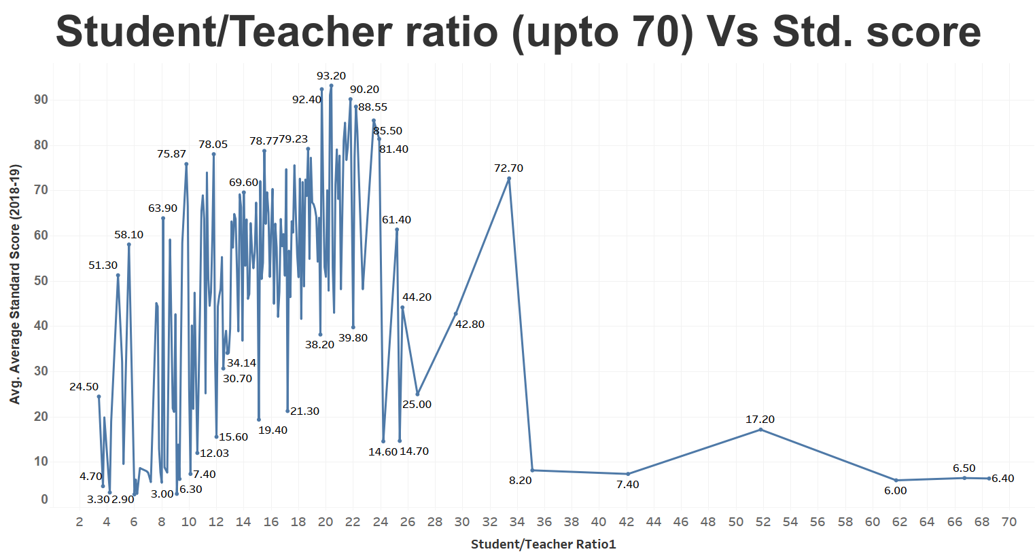
From the chart, it is inconclusive if Student/Teacher ratio affects test scores.
Minnesota High School Analytics

Slide 13
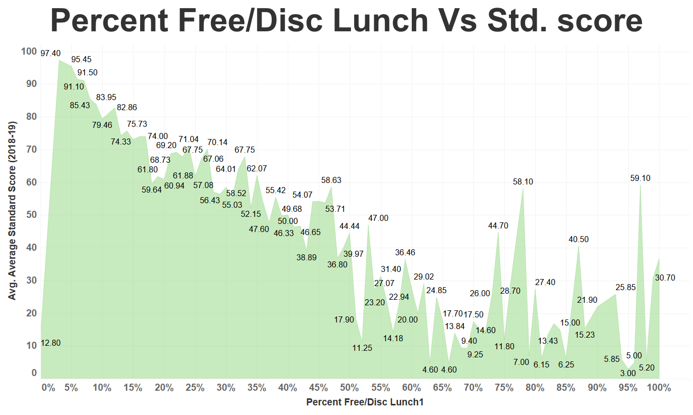
The chart shows, test scores in schools decreases with increase in percent free/ discounted lunches up to 50th percentile. After 50th percentile, its inconsistent.

Slide 14
Chi-squared test is a statistical method that measures how close expected values are to actual results. Top 5 impacting features on students test score: District, City, County, % Free/Disc. Lunch, Number of students Bottom 5 impacting features on students test score: : Percent Pacific Islander, Is Magnet, Is Virtual, Is Title, Is Charter The 10 top impacting features are listed below:
High School Chi-Squared Test Analysis
Independent variable | Chi-squared test value
District | 3458.642972
City | 3144.003962
County | 829.108435
Percent Free/Disc. lunch | 454.738338
No. of students | 256.027904
Percent White | 244.519652
No. of full-time teachers | 243.003759
Student/Teacher ratio | 185.366377
Percent African-American | 172.601077
Percent Hispanic | 171.361604

Slide 15
The correlation coefficient R, and it measures the strength and direction of a linear relationship between two variables. The value of R is always between +1 and –1. Top 3 influencing features on AVERAGE STD TEST SCORE of schools: Percent Free/Disc Lunch, Percent White, Percent Hispanic All other correlations are either weak or moderate.
High School Linear Correlation Tests Analysis
Independent Variable | R (Independent variable, Average Standard Score)
Percent Free/Disc. lunch | -0.666592
Percent White | 0.536807
Percent Hispanic | -0.370136
No. of students | 0.367106
Percent African-American | 0.353055
No. of full-time teachers | 0.335513
Percent 2 or more races | -0.256960
Percent American-Indian | -0.213414
Percent Asian | -0.0991049
Percent Pacific-Islander | -0.065140
Student/Teacher ratio | -0.0348331

Slide 16
Questions?

